Slide 1

CSE 604 Introduction to Artificial Intelligence
Chapter 8 & 9: First Order Logic
Ahmedul Kabir
Adapted from slides available in Russell & Norvig’s textbook webpage

Slide 2
Outline
Why FOL?
Syntax and semantics of FOL
Using FOL
Wumpus world in FOL
Knowledge engineering in FOL

Slide 3
Pros and cons of propositional logic
Propositional logic is declarative
Pieces of syntax correspond to fact
☺ Propositional logic allows partial/disjunctive/negated information
(unlike most data structures and databases)
Propositional logic is compositional:
meaning of B_{1,1} ∧ P_{1,2} is derived from meaning of B_{1,1} and of P_{1,2}
☺ Meaning in propositional logic is context-independent
(unlike natural language, where meaning depends on context)
☹ Propositional logic has very limited expressive power
(unlike natural language)
E.g., cannot say "pits cause breezes in adjacent squares“
except by writing one sentence for each square

Slide 4
First-order logic
Whereas propositional logic assumes the world contains facts,
first-order logic (like natural language) assumes the world contains
Objects: people, houses, numbers, colors, baseball games, wars, …
Relations: red, round, prime, brother of, bigger than, part of, comes between, …
Functions: father of, best friend, one more than, plus, …

Slide 5
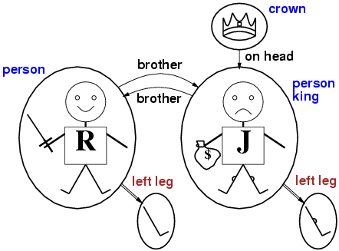
Models for FOL: Example

Slide 6
Syntax of FOL: Basic elements
Constants KingJohn, 2, IIT,...
Predicates Brother, King, >,...
Functions Sqrt, LeftLegOf,...
Variables x, y, a, b,...
Connectives ¬, ⇒, ∧, ∨, ⇔
Equality =
Quantifiers ∀, ∃

Slide 7
Atomic sentences
Atomic sentence = predicate (term₁, ..., term_{n}) or term₁ = term₂
Term = function (term₁, ..., term_{n}) or constant or variable
E.g., Brother(KingJohn,RichardTheLionheart)
> (Length(LeftLegOf(Richard)), Length(LeftLegOf(KingJohn)))

Slide 8
Complex sentences
Complex sentences are made from atomic sentences using connectives
¬S, S₁ ∧ S₂, S₁ ∨ S₂, S₁ ⇒ S₂, S₁ ⇔ S₂,
E.g. Sibling(KingJohn,Richard) ⇒ Sibling(Richard,KingJohn)
>(1,2) ∨ ≤ (1,2)
>(1,2) ∧ ¬ >(1,2)

Slide 9
Truth in first-order logic
Sentences are true with respect to a model and an interpretation
Model contains objects (domain elements) and relations among them
Interpretation specifies referents for
constant symbols → objects
predicate symbols → relations
function symbols → functional relations
An atomic sentence predicate(term₁,...,term_{n}) is true
iff the objects referred to by term₁,...,term_{n}
are in the relation referred to by predicate

Slide 10
Universal quantification
∀<variables> <sentence>
Everyone at IIT is smart:
∀x At(x, IIT) ⇒ Smart(x)
∀x P is true in a model m iff P is true with x being each possible object in the model
Roughly speaking, equivalent to the conjunction of instantiations of P
At(KingJohn,IIT) ⇒ Smart(KingJohn)
∧ At(Richard,IIT) ⇒ Smart(Richard)
∧ At(Ananta Jalil, IIT) ⇒ Smart(Ananta Jalil)
∧ ...

Slide 11
A common mistake to avoid
Typically, ⇒ is the main connective with ∀
Common mistake: using ∧ as the main connective with ∀:
∀x At(x, IIT) ∧ Smart(x)
means “Everyone is at IIT and everyone is smart”!

Slide 12
Existential quantification
∃<variables> <sentence>
Someone at CSE is smart:
∃x At(x, CSE) ∧ Smart(x)
∃x P is true in a model m iff P is true with x being some possible object in the model
Roughly speaking, equivalent to the disjunction of instantiations of P
At(KingJohn, CSE) ∧ Smart(KingJohn)
∨ At(Richard, CSE) ∧ Smart(Richard)
∨ At(Pikachu, CSE) ∧ Smart(Pikachu)
∨ ...

Slide 13
Another common mistake to avoid
Typically, ∧ is the main connective with ∃
Common mistake: using ⇒ as the main connective with ∃:
∃x At(x, IIT) ⇒ Smart(x)
is true if there is anyone who is not at IIT!

Slide 14
Properties of quantifiers
∀x ∀y is the same as ∀y ∀x
∃x ∃y is the same as ∃y ∃x
∃x ∀y is not the same as ∀y ∃x
∃x ∀y Loves(x,y)
“There is a person who loves everyone in the world”
∀y ∃x Loves(x,y)
“Everyone in the world is loved by at least one person”
Quantifier duality: each can be expressed using the other
∀x Likes(x,IceCream) ¬∃x ¬Likes(x,IceCream)
∃x Likes(x,Broccoli) ¬∀x ¬Likes(x,Broccoli)

Slide 15
Fun with sentences
Brothers are siblings
∀x,y Brother(x,y) ⇒ Sibling(x,y)
“Sibling” is symmetric
∀x,y Sibling(x,y) ⇔ Sibling(y,x)
One's mother is one's female parent
∀m,c Mother(c) = m ⇔ (Female(m) ∧ Parent(m,c))
First cousin is a child of a parent’s sibling
∀ x, y FirstCousin(x, y) ⇔ ∃ p, ps Parent(p, x) ∧ Sibling(ps, p) ∧ Parent(ps, y)

Slide 16
FOL in Wumpus World

Slide 17
Inference in first-order logic
Chapter 9

Slide 18
Example knowledge base
The law says that it is a crime for an American to sell weapons to hostile nations. The country Nono, an enemy of America, has some missiles, and all of its missiles were sold to it by Colonel West, who is American.
Prove that Col. West is a criminal

Slide 19
Example knowledge base contd.
... it is a crime for an American to sell weapons to hostile nations:
American(x) ∧ Weapon(y) ∧ Sells(x,y,z) ∧ Hostile(z) ⇒ Criminal(x)
Nono … has some missiles, i.e., ∃x Owns(Nono,x) ∧ Missile(x):
Owns(Nono,M₁) and Missile(M₁)
… all of its missiles were sold to it by Colonel West
Missile(x) ∧ Owns(Nono,x) ⇒ Sells(West,x,Nono)
Missiles are weapons:
Missile(x) ⇒ Weapon(x)
An enemy of America counts as "hostile”:
Enemy(x,America) ⇒ Hostile(x)
West, who is American …
American(West)
The country Nono, an enemy of America …
Enemy(Nono,America)

Slide 20
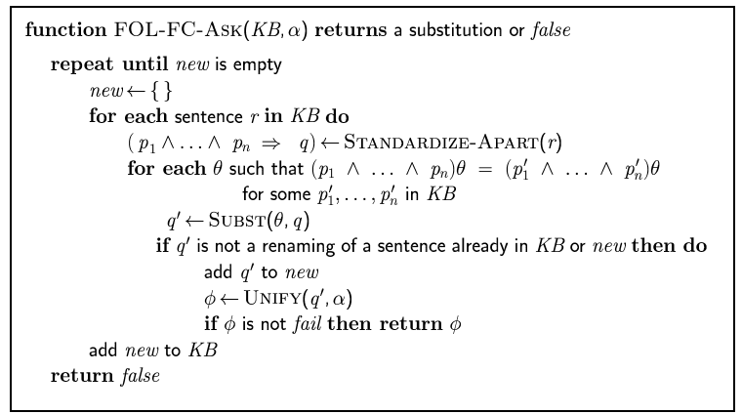
Forward chaining algorithm

Slide 21
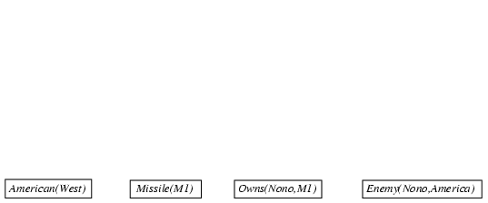
Forward chaining proof

Slide 22
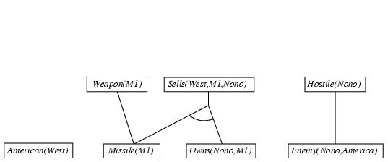
Forward chaining proof

Slide 23
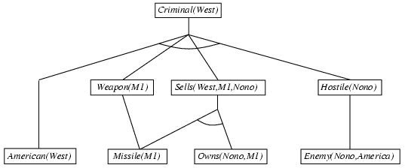
Forward chaining proof

Slide 24
Properties of forward chaining
Sound and complete for first-order definite clauses
Datalog = first-order definite clauses + no functions
FC terminates for Datalog in finite number of iterations
May not terminate in general if α is not entailed
This is unavoidable: entailment with definite clauses is semidecidable

Slide 25
Efficiency of forward chaining
Incremental forward chaining: no need to match a rule on iteration k if a premise wasn't added on iteration k-1
⇒ match each rule whose premise contains a newly added positive literal
Matching itself can be expensive:
Database indexing allows O(1) retrieval of known facts
e.g., query Missile(x) retrieves Missile(M₁)
Forward chaining is widely used in deductive databases

Slide 26
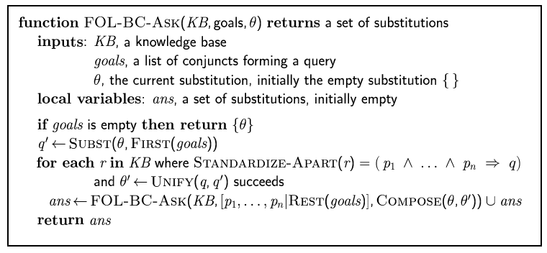
Backward chaining algorithm
SUBST(COMPOSE(θ₁, θ₂), p) = SUBST(θ₂, SUBST(θ₁, p))

Slide 27

Backward chaining example

Slide 28
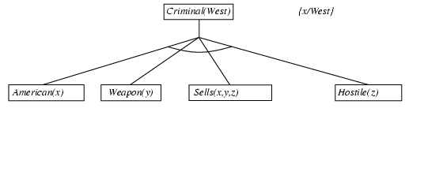
Backward chaining example

Slide 29
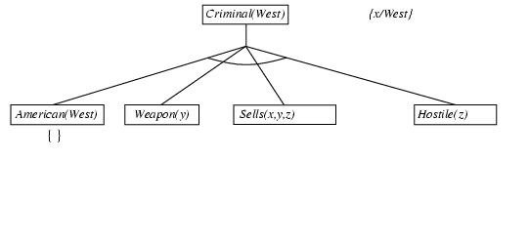
Backward chaining example

Slide 30
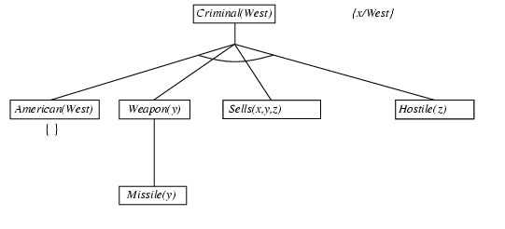
Backward chaining example

Slide 31
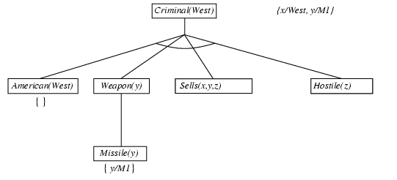
Backward chaining example

Slide 32
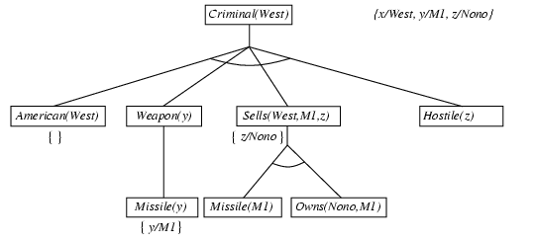
Backward chaining example

Slide 33
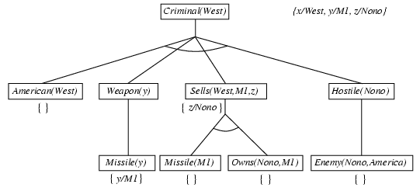
Backward chaining example

Slide 34
Properties of backward chaining
Depth-first recursive proof search: space is linear in size of proof
Incomplete due to infinite loops
⇒ fix by checking current goal against every goal on stack
Inefficient due to repeated subgoals (both success and failure)
⇒ fix using caching of previous results (extra space)
Widely used for logic programming

